Slide 1

Lean Six Sigma Case Study Gentech
Team Members:
Te-Chun Chou Akash Kumar Preveen Veerakumar Parv Khandelwal Anila Catherine Scaria

Slide 2

Agenda
Project Charter
Process map
Chart Analysis
Quantitative Analysis
Recommendation & Control Plan

Slide 3
Project Charter

Slide 4
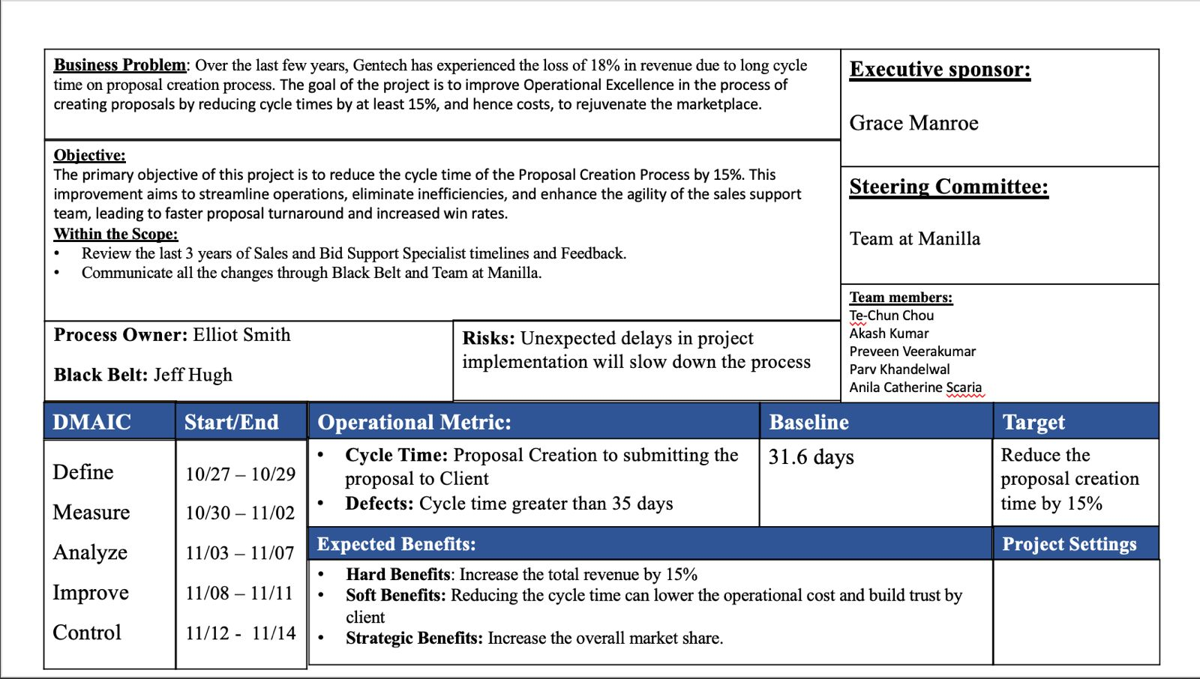

Slide 5
Process Map

Slide 6
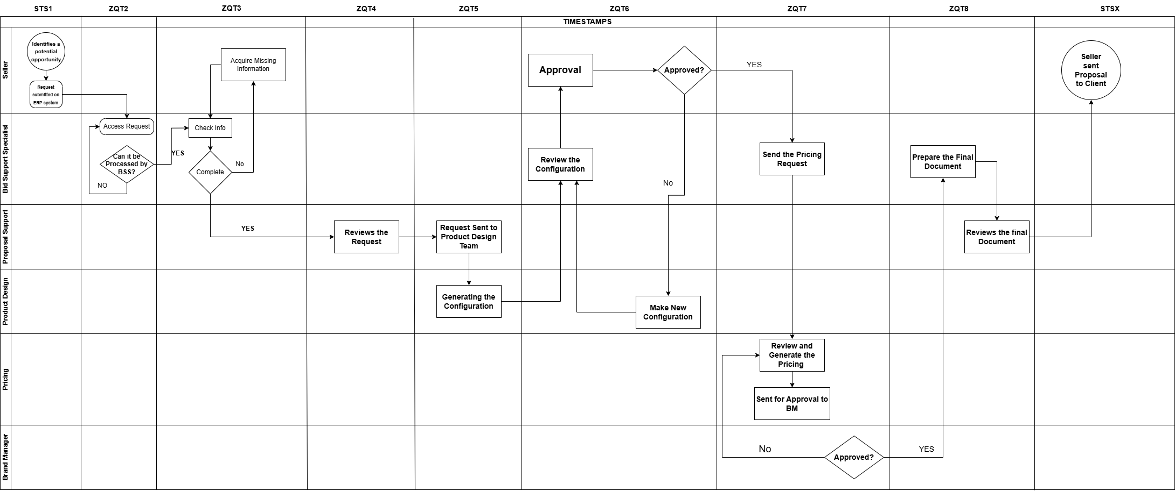

Slide 7
Chart Analysis

Slide 8
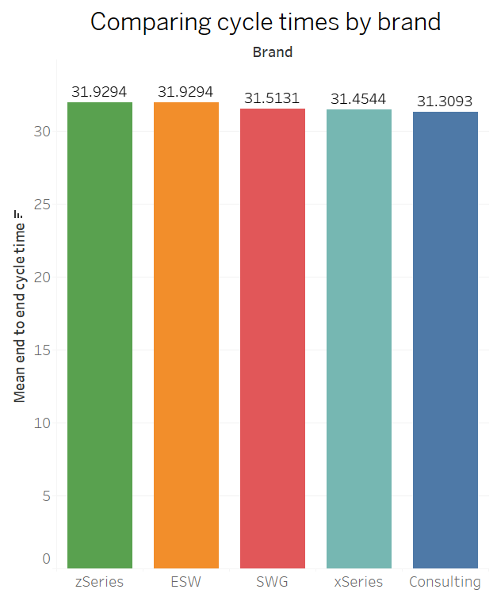
Comparison of cycle time by brand
The mean cycle times across all brands are very similar.
This indicates consistent operational efficiency across brands.

Slide 9
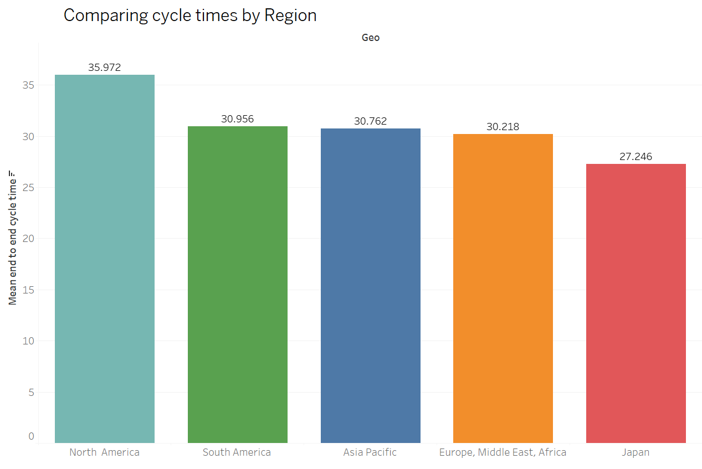
Comparison of cycle time by region
The chart shows that North America has the highest mean cycle time at 35.972, while Japan has the lowest at 27.246.
Other regions (South America, Asia Pacific, and EMEA) have similar cycle times around 30.

Slide 10
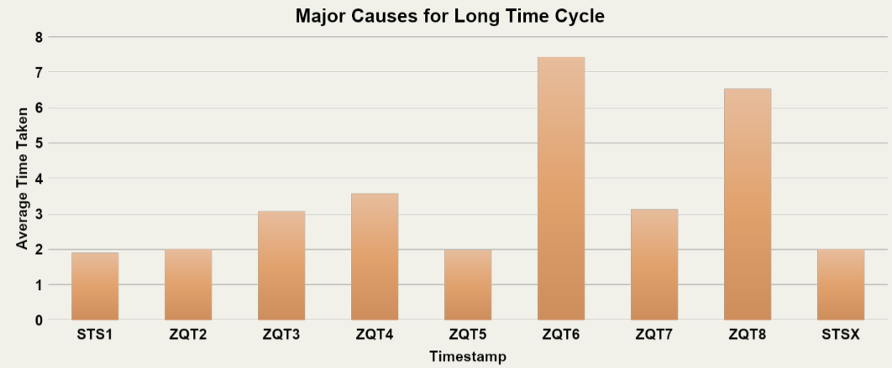
Major Causes for Long Time Cycle
ZTQ6, Review Configuration, contribute most to the long cycletime.

Slide 11
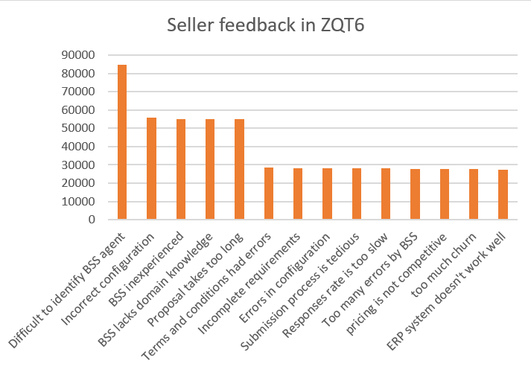
Major Causes for Long Time Cycle
The primary concerns are related to identifying the right agents, configuration issues, and agent experience.
Addressing these top issues could improve overall seller satisfaction significantly.

Slide 12
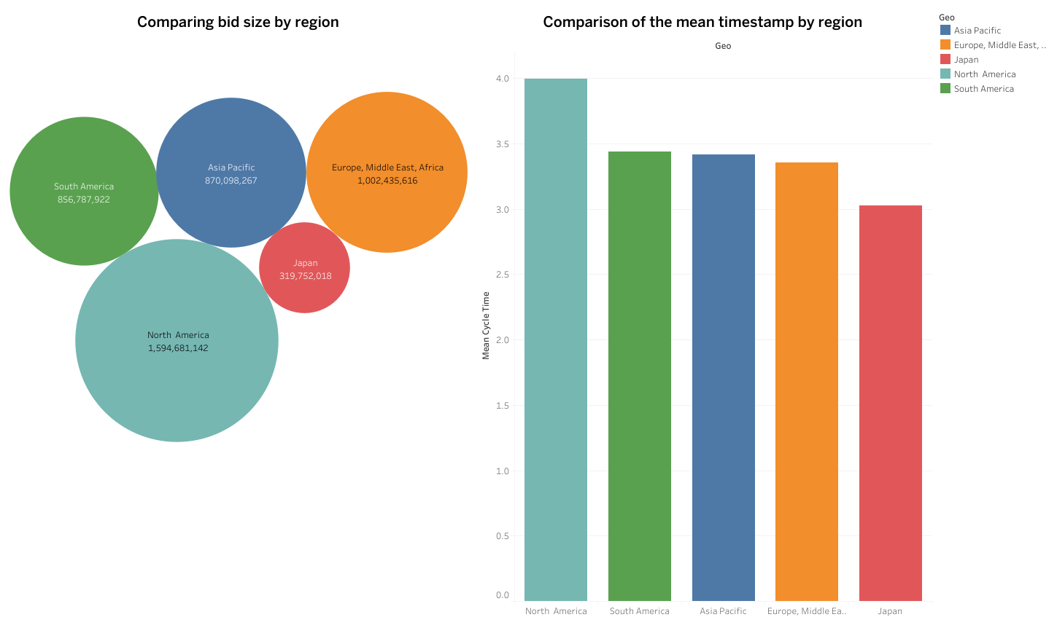
The Performance of Different Brands and Geos
North America has the largest bid size, while Japan has the lowest.
The mean cycle times are relatively close across regions, but North America has the highest mean cycle time, while Japan has the lowest.
This suggests that North America may face more complex or time-consuming processes, while Japan operates more efficiently.

Slide 13
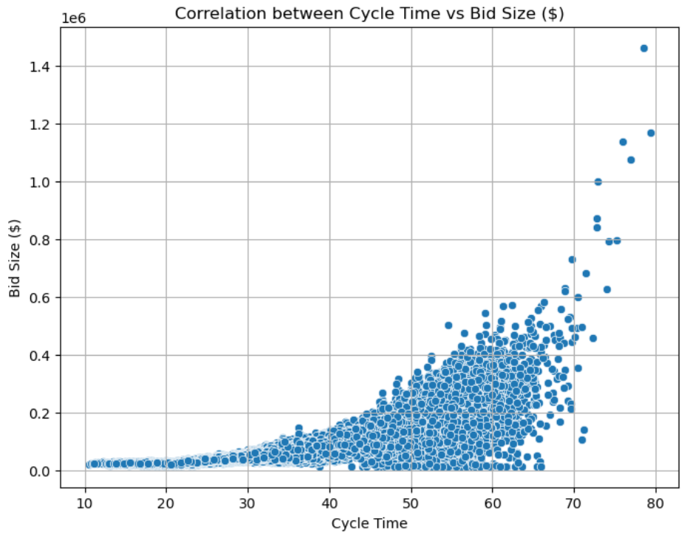
The Performance of Different Brands and Geos
This indicates that larger bids generally require more time to process.
Possibly due to increased complexity or resource allocation.

Slide 14
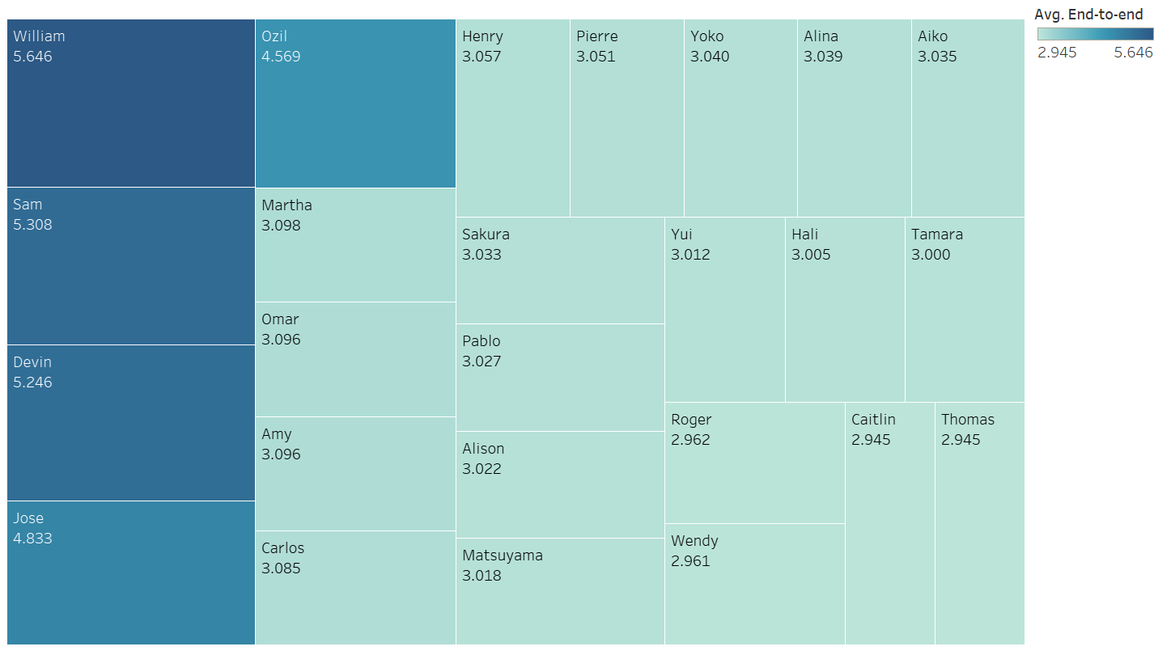
Average cycle time per seller
William and Sam have the highest cycle times.
Caitlin and Thomas, indicating higher efficiency in their processes.

Slide 15
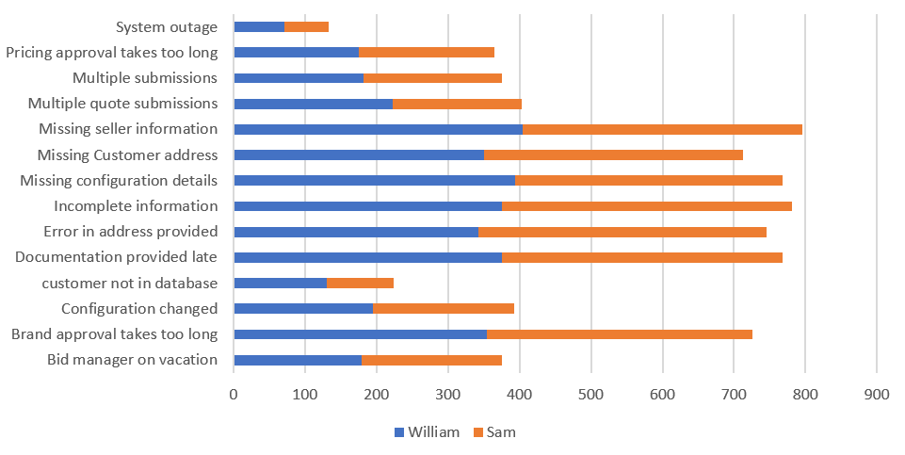
Seller feedback comparison
These common issues indicate that there are bottlenecks in the brand approval and documentation submission processes.
Improving these areas could help reduce overall processing time for both individuals.

Slide 16
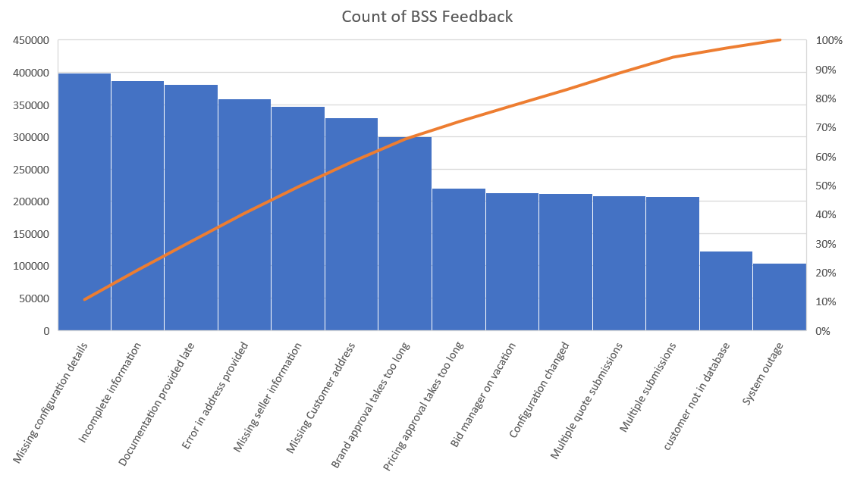
Pareto Chart with BSS Feedback
Addressing the Missing configuration details, Incomplete information could significantly reduce the overall feedback volume.

Slide 17
FISH BONE DIAGRAM
People
Process
Technology
ERP system delays and inefficiencies
Inexperienced Bid Support Staff
Non-standard practices across regions
Excessive approval steps
Insufficient training for BSS agents
Manual data entry requirements
Inefficient hand-offs between departments
Delayed Proposal creation
Lack of process automation
Frequent rework due to missing information
Time zone challenges affecting communication
Inconsistent cycle time metrics
Incomplete data provided by sellers
No standardized process tracking
High workload during peak sales periods
Information
Measurement
Environment

Slide 18
Quantitative Analysis

Slide 19


DPMO & Sigma Level
DPMO = (21079 / 75000 ​)× 1,000,000 = 281053
Sigma Level = 2.08

Slide 20
Recommendation & Control Plan
Establish an automated system to keep the process on track by using Key Performance Indicators (KPIs).
Create standardized frameworks for bids to ensure they are complete and to help BSS agents align with the correct bids.
Eliminate the practice of sending bids directly to BSS.
The seller must approve the BSS request sent to the design team, ensuring the configuration is properly outlined, thus avoiding the need for reconfigurations.
Set up KPI measures to ensure each step is completed on time.
Use automated systems to prevent BSS from sending bids personally.
Adopt Standard Operating Procedures (SOPs) and standardized frameworks to ensure all paperwork is properly filled out and accurate.

Slide 21
IMPROVEMENT & SUGGESTIONS
Reduce Hand-offs and Streamline Communication: To reduce the need for frequent transfers, consolidate jobs where feasible and improve BSS's cross-functional training. Establish a single platform for communication to monitor progress and cut down on hand-off delays.
Improve Data Collection and Standardize Requirements: Introduce a checklist in the ERP system that requires Sellers to submit all necessary information upfront before a request can move forward. This will help eliminate delays caused by missing data.
Enhance Training for Bid Support Specialists: Provide additional training and resources for BSS, focusing on handling complex transactions and understanding product specifications. This will reduce the need for Seller intervention and speed up the process

